Slide 1



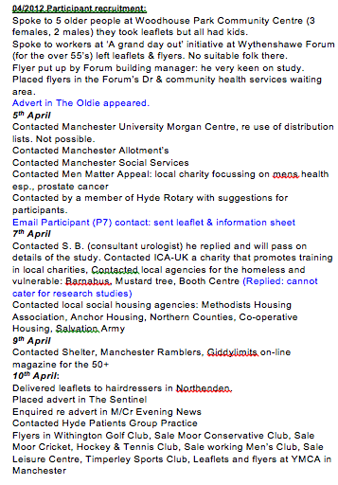
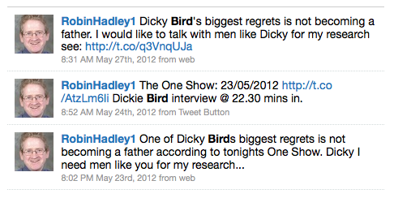
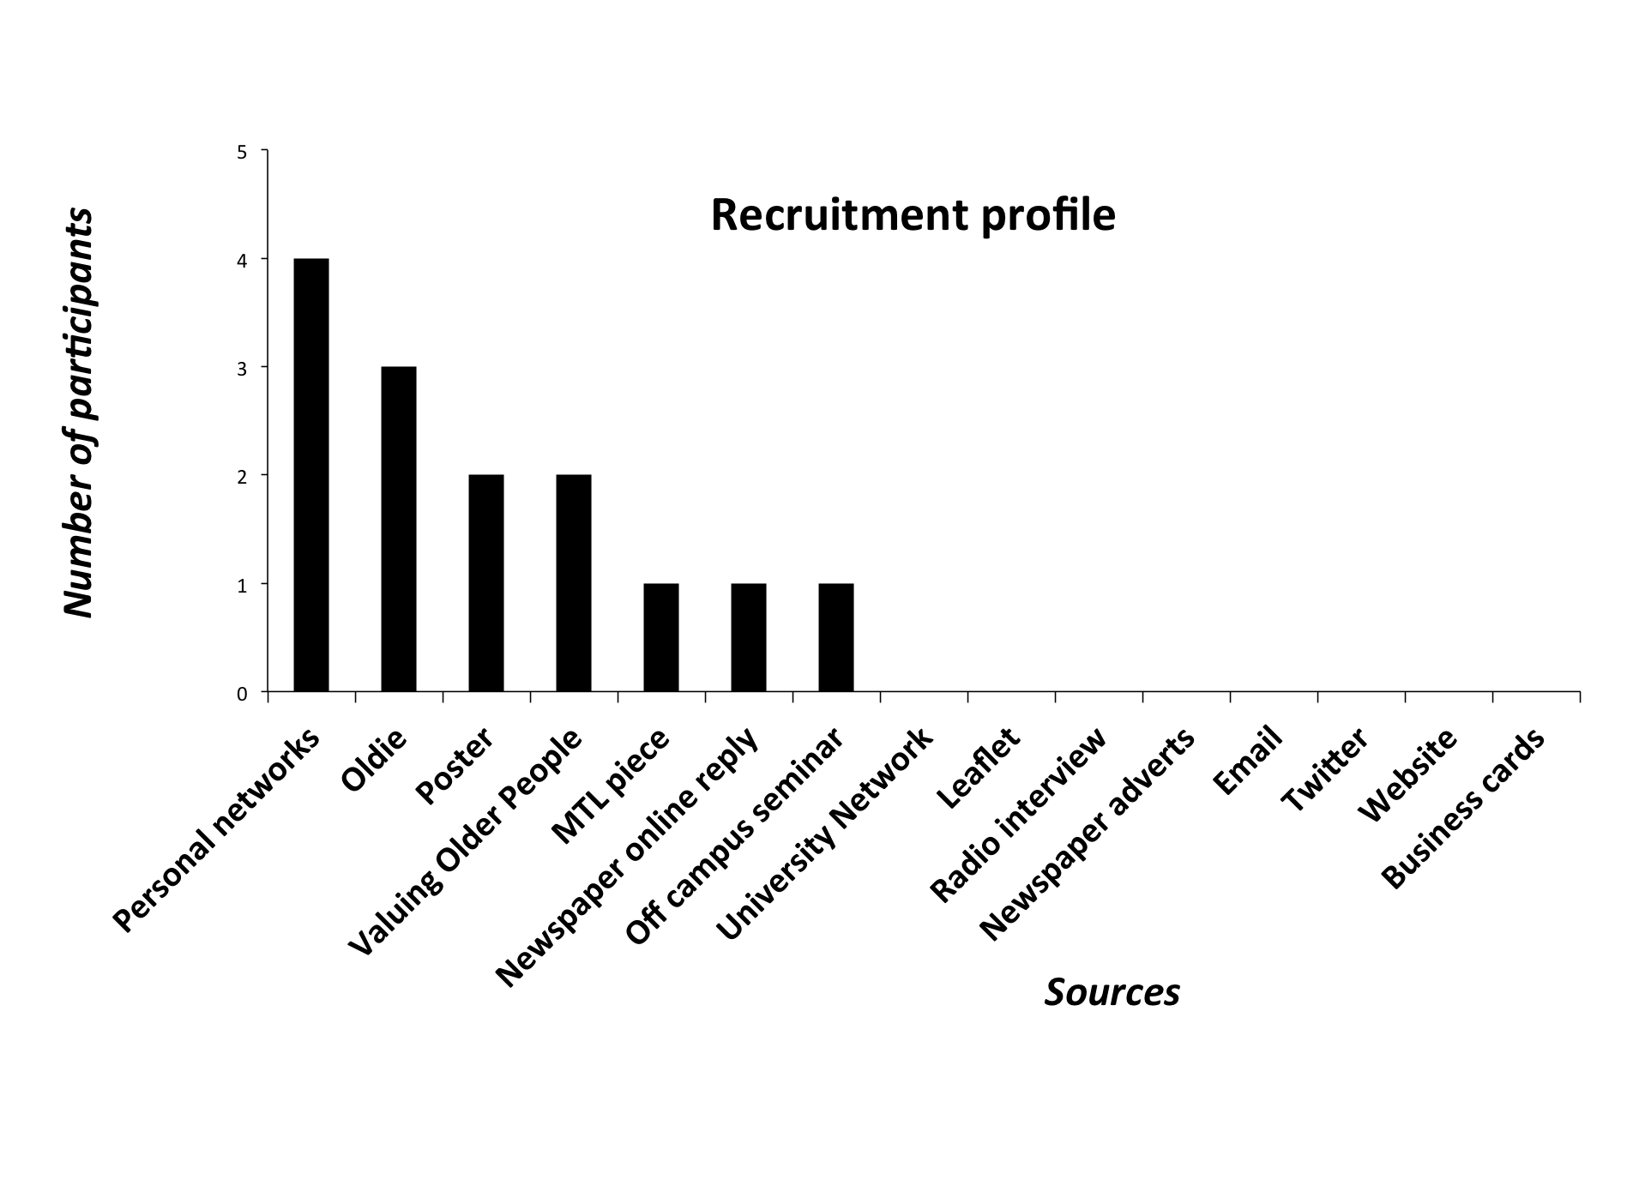

Locating the lacunae:
Issues in recruiting male participants for interview in a sensitive subject
Robin Hadley, PhD candidate, Keele University. Email: r.a.hadley@keele.ac.uk
1. Introduction
4. Initial recruitment method
The aim of this study was to examine the lives of older involuntarily childless (IvC) men. Research in the field of older IvC men is important, not only because of an increasingly ageing population and a declining fertility rate (Dykstra 2009), but also because of the lack of research material on men as they age (Dykstra and Keizer, 2009) Divorced and widowed childless men show higher rates of depression than same status women (Zhang and Hayward, 2001). Older childless men have smaller social networks and are poorer in terms of health, diet, self-care, and wellbeing than those married with children (Dykstra and Keizer, 2009).
Initial recruitment methods included:
Snowball sampling: recommended method for hard-to-reach groups.
3rd party contacts of personal and university networks, friends, partners, colleagues.
Method used: email, letters, leaflets posters, strategic organisations: AgeUK; BJF; U3A (local & national), VOP (M/cr), More-To-Life, MENSFE.
Local leafleting: café’s, GP surgeries, shops, theatres etc.,
Problem 1: No respondents.
Problem 2: Recruiters reported difficulty in broaching such a sensitive subject.
Figure 1 : ‘Missing the fish’: my feelings during initial recruitment.
2. Lacunae
5. Solution
Men are missing from both childlessness and ageing research. Childlessness is typically divided into two types ‘voluntary’ and ‘involuntary.’ Most research focuses on the latter and is based on those in pre, participating in, or post, infertility treatment. Men are generally excluded from this research (Dykstra and Keizer 2009). Most gerontological research has focussed on older women, as they lived longer, had high chronic co-morbidities, received more state benefits, and occupied the majority of the home care sector (Arber et al, 2003; Arber, 2004). Financial research has focused on differences in women’s marital status (Arber, 2004).
Researcher response: frustration (Fig., 1).
Reviewed Initial progress with supervisors:
Listened to feedback
Reviewed recruitment material
Broadened approach to be more personal and direct: face-to-face (Fig., 2)
Increase social media profile: set up website and linked to twitter (Fig., 3)
Interviewed on local radio
Advertised in the ‘Oldie’ and local newspapers. Wrote an article for More-To-Life newsletter.
Table 1 shows the the different strategies
Figure 2 : Research diary extract of the recruitment methods undertaken.
3. Why hard to reach?
6. Conclusion
This group is hard to reach because:
Sensitive topic
Men’s fertility intentions and history is not recorded
Childlessness viewed as a deep personal and social loss and generally associated with women.
Men castigated as ‘not interested’ by researchers
I am not an insider to any group such as health and care services or any charity
Table 1 : The successful recruitment strategies
The final sample consisted of:
14 men aged between 49 -82 years.
13 of the participants were White-British, one Australian
Two Non-heterosexual and 12 heterosexual
13 participants were interviewed twice. One refused the second interview. 11 men interviewed face-to-face, 1 Skype, 1 email, and 1 telephone
Interviews lasted from 1hr 57 mins., to 7hrs 58minutes
Figure 3: Example of a recruitment ‘tweet’

